Slide 1

TN COVID 19 DATA
COVID 19 Analysis In Tn
By Osamah Neamah

Slide 2
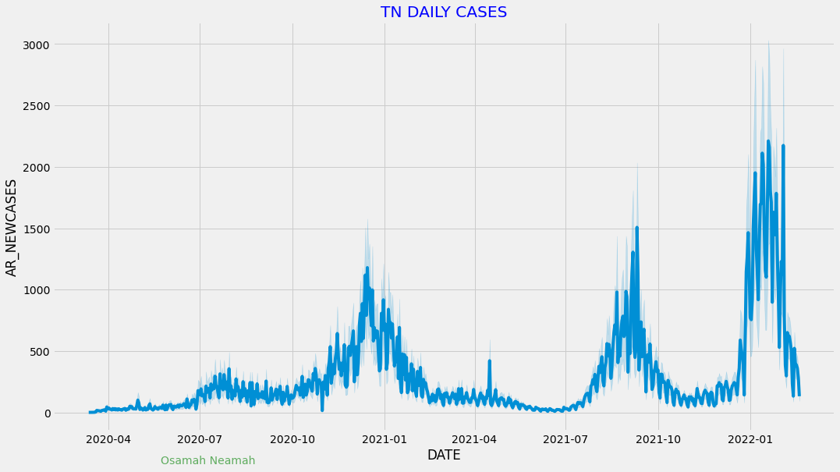
Tn Daily Cases Plot

Slide 3
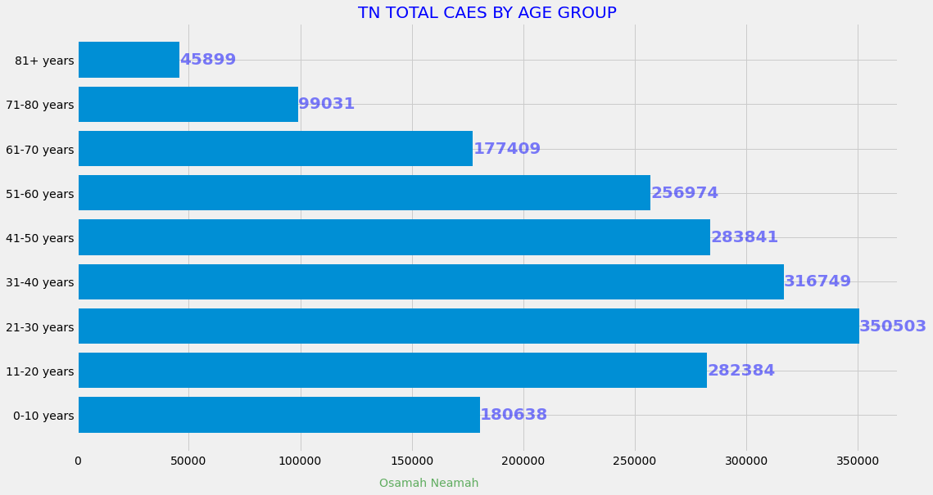
TN Total Cases By Age Group

Slide 4
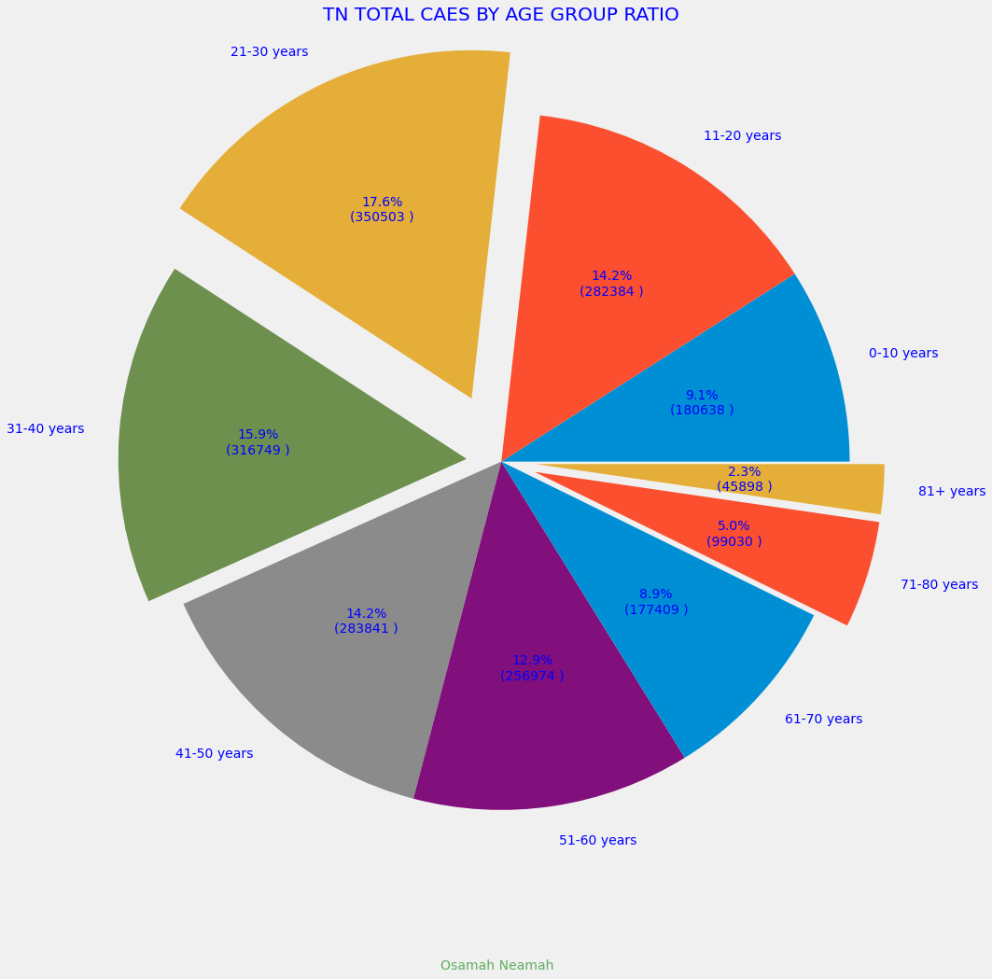
TN Total Cases By Age Group Ratio

Slide 5
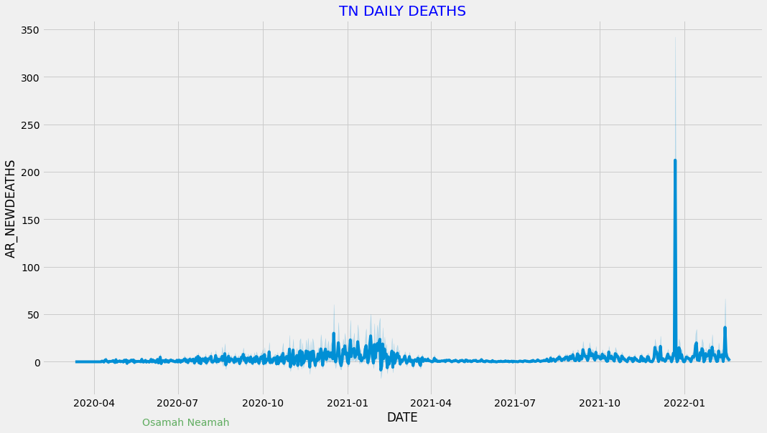
TN Daily Death Plot

Slide 6
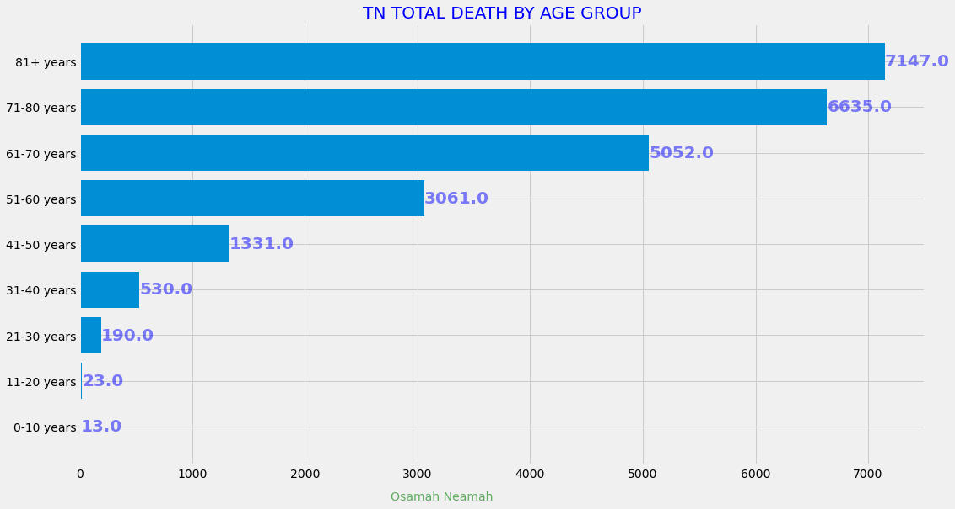
TN Total Death By Age Group

Slide 7
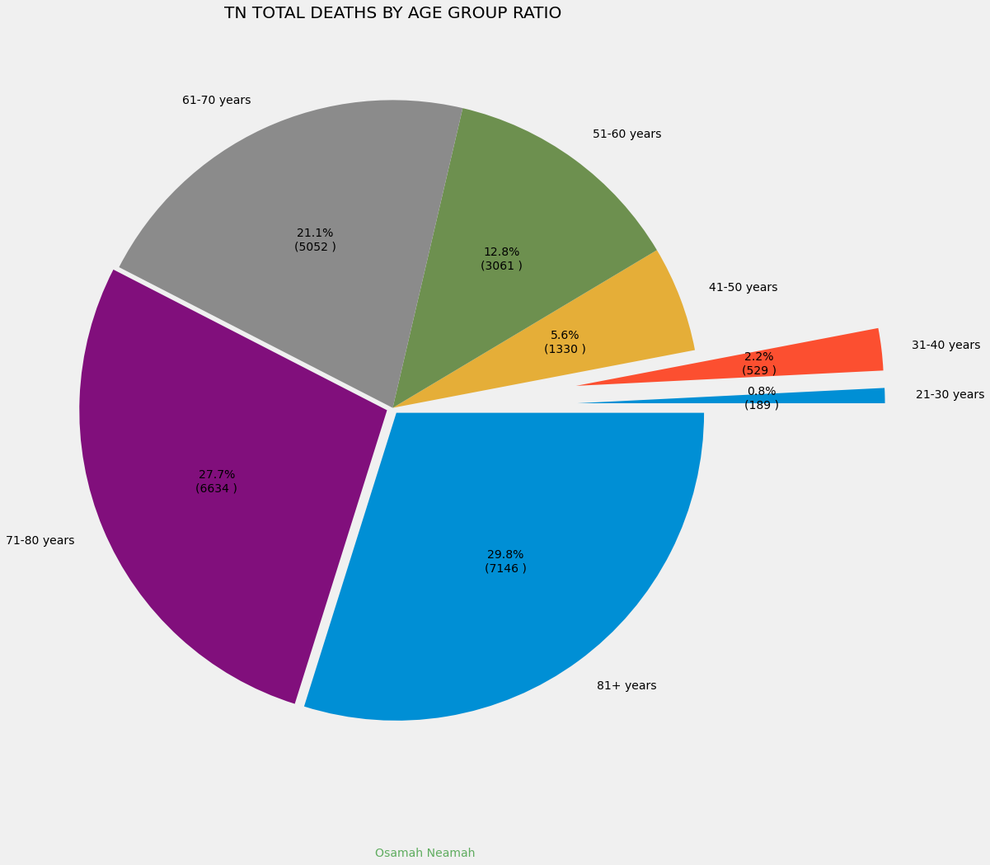
TN Total Death By Age Group Ratio

Slide 8
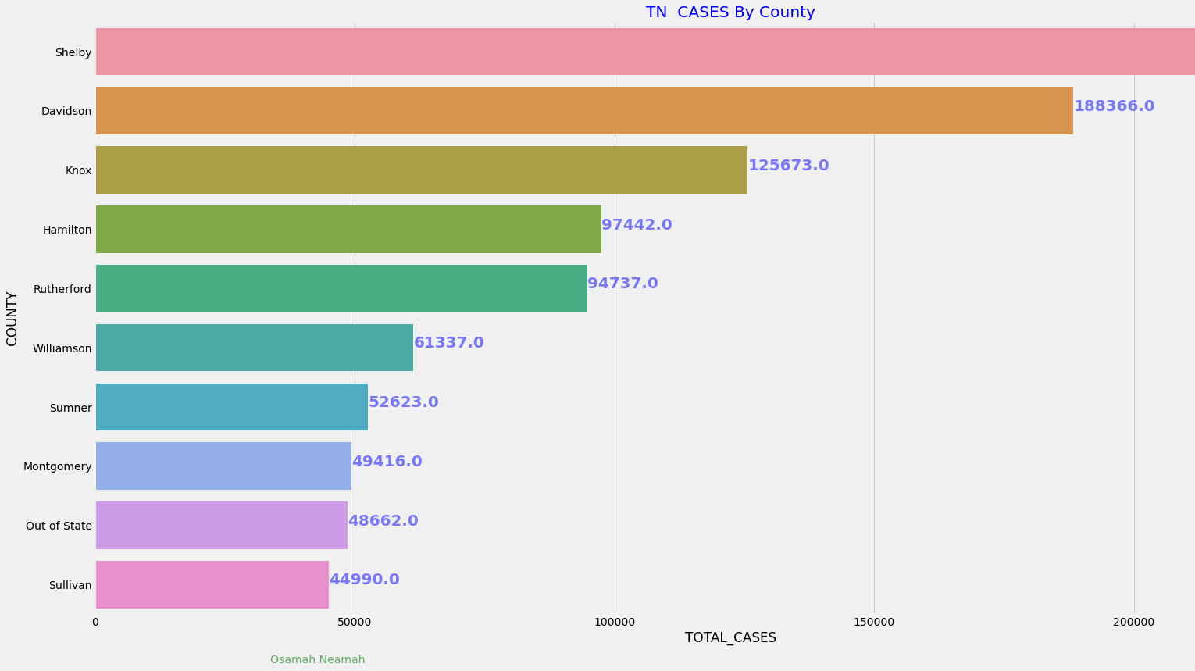
TN Cases Top 10 Counties

Slide 9
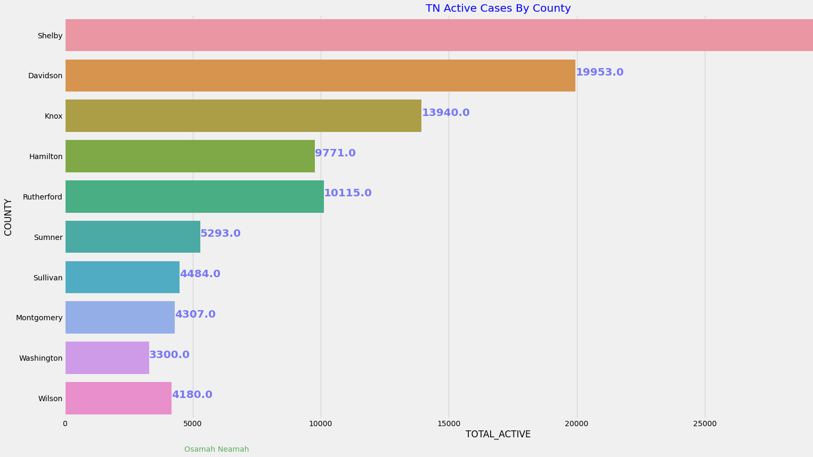
TN Active Cases Top 10 Counties

Slide 10
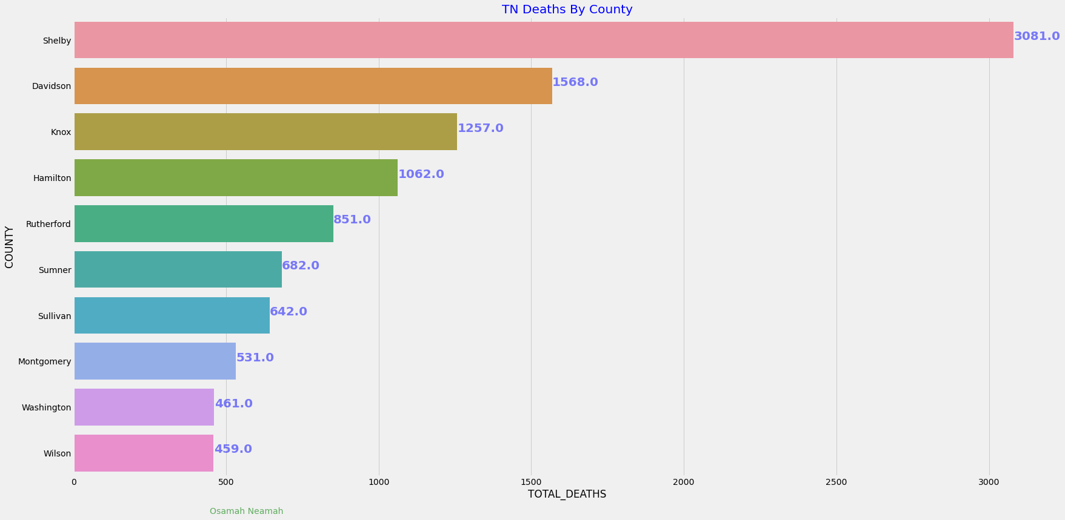
TN Deaths Top 10 Counties

Slide 11
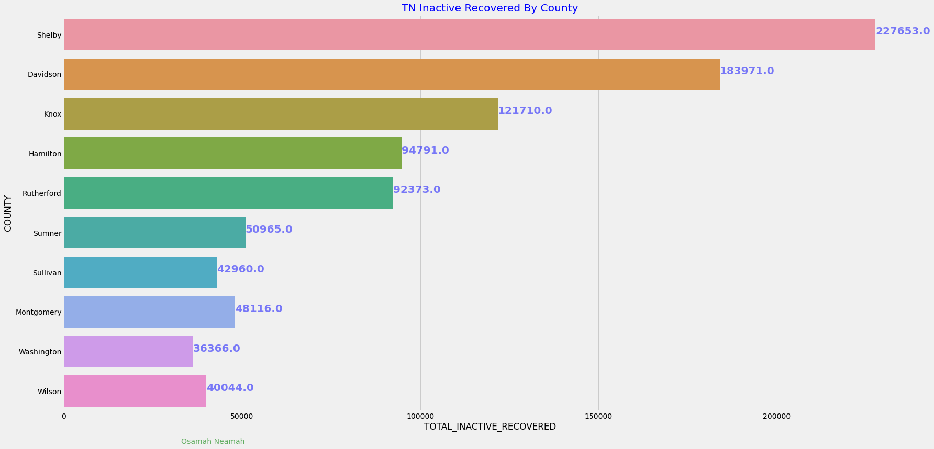
TN Inactive Cases Top 10 Counties

Slide 12
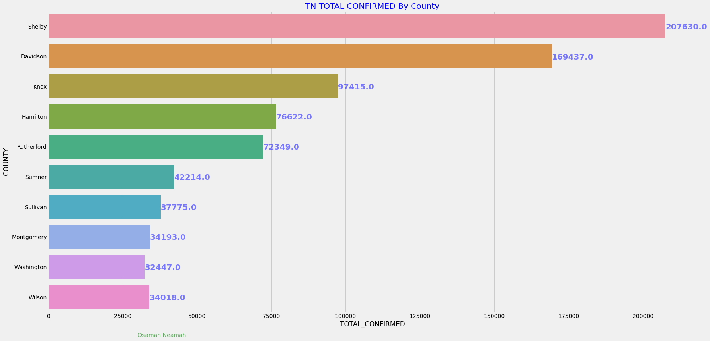
TN Total Confirmed By County

Slide 13
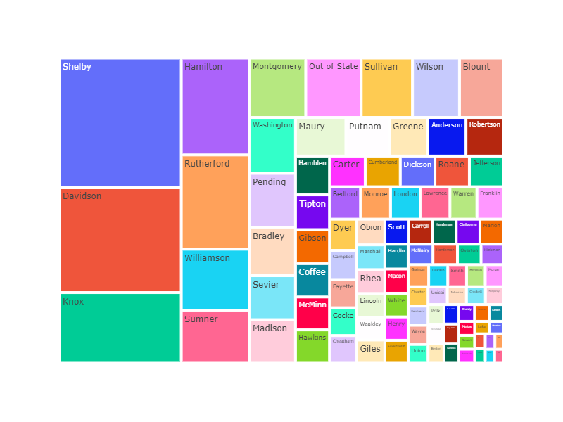
TN Total Cases By Counties

Slide 14

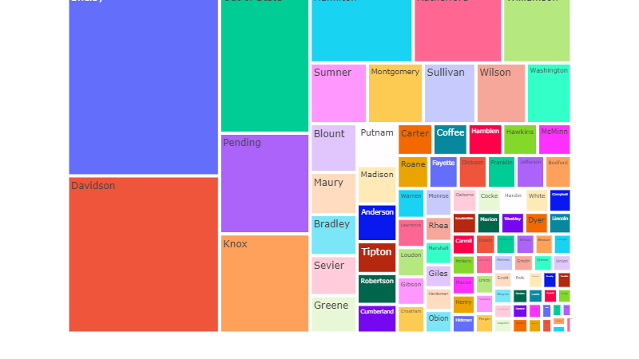
TN Total Tests By County

Slide 15
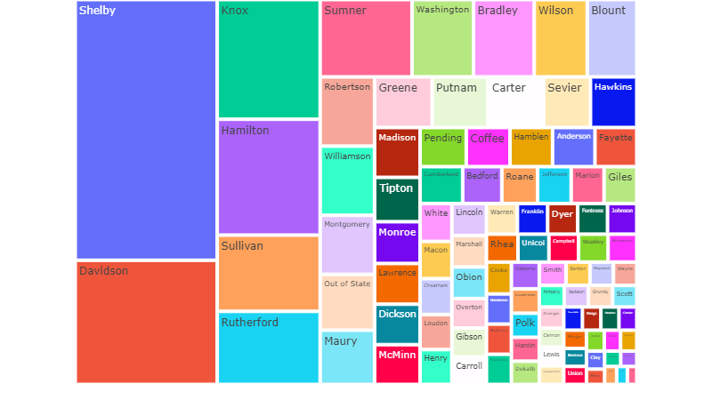
TN Total Hospitalized By County

Slide 16
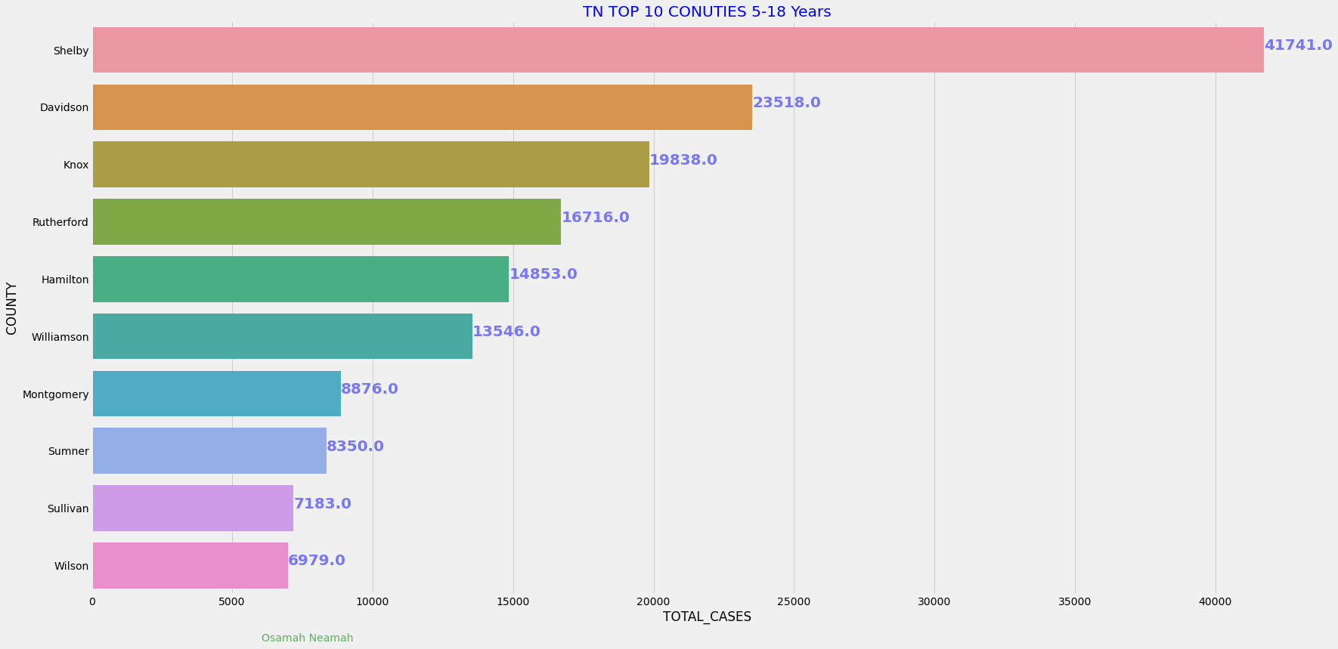
TN Top 10 Counties 5-18 Years

Slide 17
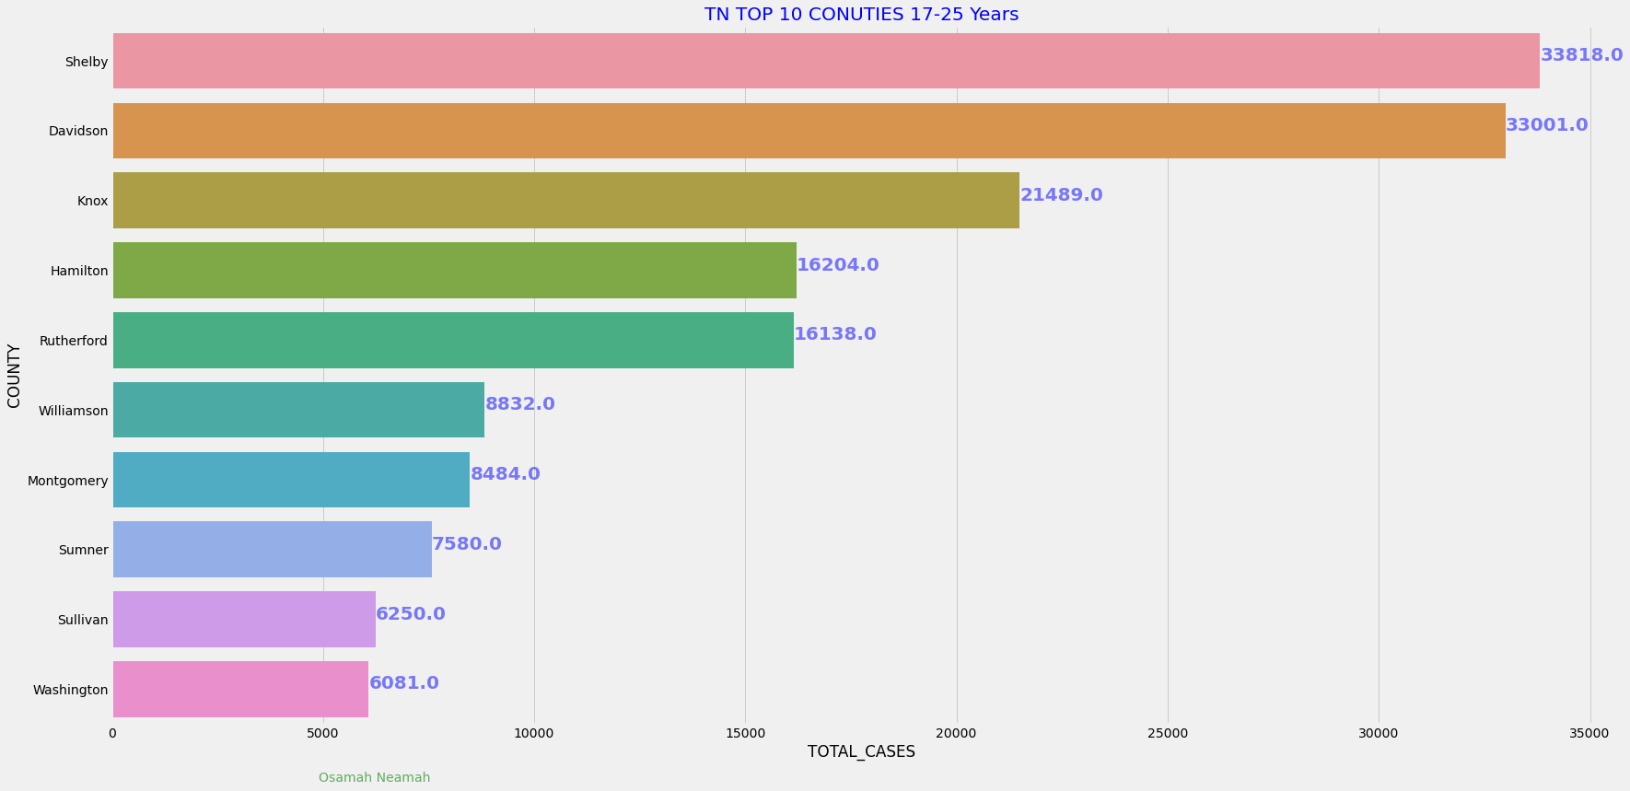
TN Top 10 Counties 17-25 Years

